Slide 1

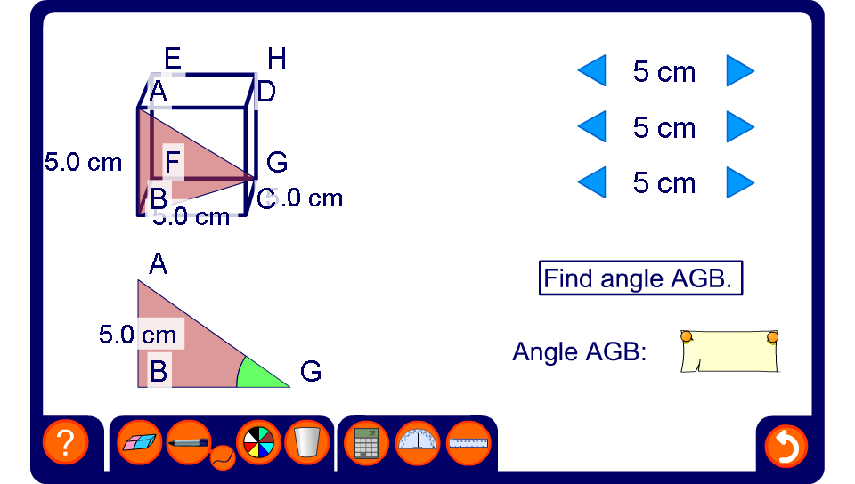


Angles in a cuboid
Notes:
Stress that when solving problems involving right-angled triangles in 3-D, we should always draw a 2-D diagram of the right-angled triangle in question, labelling all the known sides and angles.
Show how angle ACE can be found by first using Pythagoras’ theorem to find the length of AC.
Once we know the length of AC we can find angle ACE using the tangent ratio.
Reveal the answer. If there is a small discrepancy, this is due to rounding.
Change the size of the cuboid and ask a volunteer to calculate the new size of angle ACE.

